Slide 1
Azure Data Factory V2

Slide 2



Slide 3
Agenda
Background
Dive deeper into Azure Data Factory
Demo
Notes:
What is LoCD? A masterdata system for company data.

Slide 4
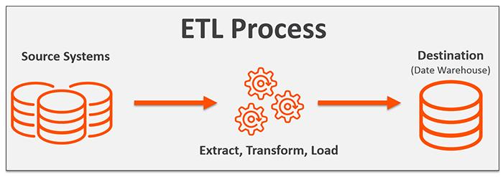
ETL

Slide 5









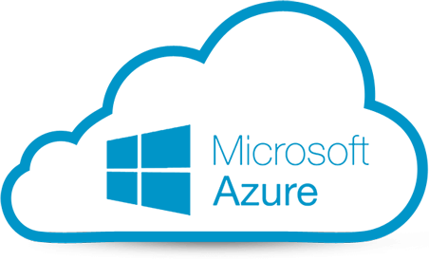
Azure Data Factory
“The Azure Data Factory service is a fully managed service for composing data storage, processing, and movement services into streamlined, scalable, and reliable data production pipelines”
=
+
Notes:
In Microsofts own words...
TO betThere is a concept called ETL
SSIS is stronger in ETL, where ADF is faster

Slide 6
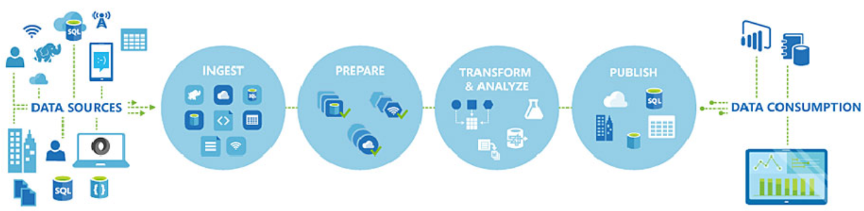
Typical usage of Azure Data Factory
Notes:
Read the data
Validation, basic mapping
Transform
Push to your instance of whatever

Slide 7
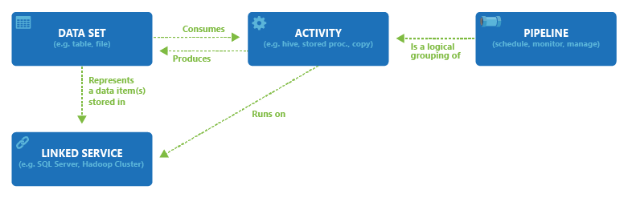
Concepts
Notes:
All activities in a pipeline are deployed, scheduled, or
deleted as one single unit instead of managing each
individual activity independently

Slide 8
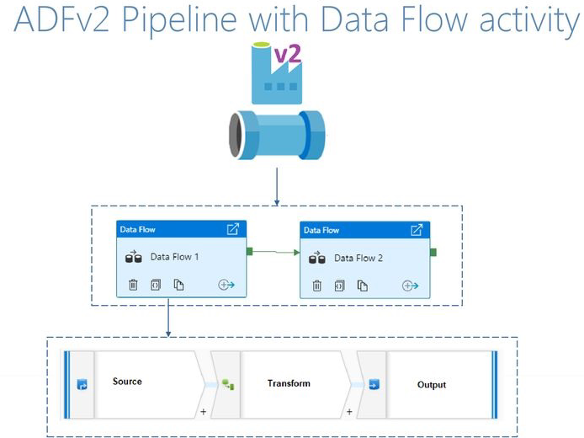
Azure Data Factory Pipeline
Different Data Source
integration
ETL/ELT

Slide 9
When to use ADF?
Create on demand or event triggered pipelines
Work with all my data across cloud and on-prem
Data movement at scale
Pipelines spanning services and servers
For when data integrators are not developers
For when you want to move your SSIS investments to the cloud

Slide 10
Q&A

